Slide 1

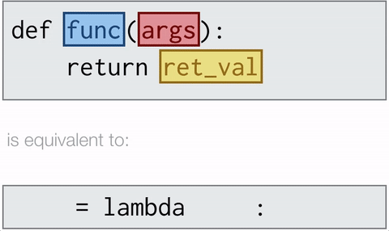
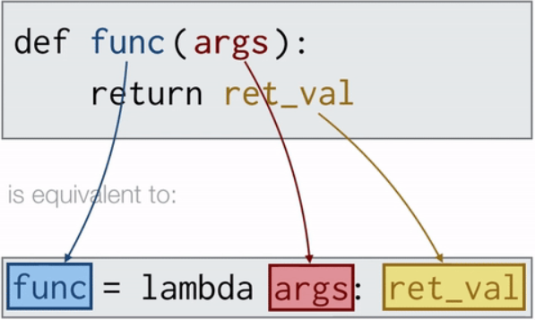
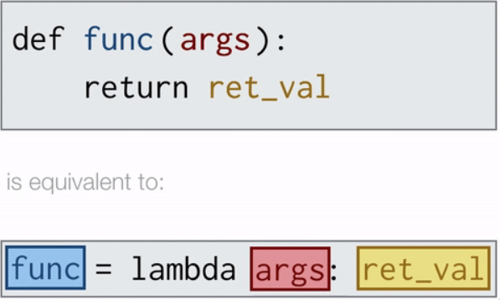
Lambda
●Lambda functions are anonymous, i.e. to say they have no names
●The lambda is a keyword and a one-line function
●No def or return keyword and arguments can be many expression is only one.
●Lambdas are used when a function is needed temporarily and used inside another function such as filter, map and reduce.
Why Lambda?
●Using lambda function, you can define a function and call it immediately.
●In our understanding lambda functions and user defined functions work exactly same with the exception that less coding in lambda.
Simple lambda function:
square = lambda x : x**2
cube = lambda x : x ** 3

Slide 2
Lambda Sample Code along with other functions
Along with Reduce:
my_list = list(range(1,101,1))
print(ft.reduce(lambda x,y: x+y ,my_list))
Over Usage of Lambda:
import functools.reduce
numbers = [2, 1, 3, 4, 7, 11, 18]
total = reduce(lambda x, y: x + y, numbers)
Above can be written as
numbers = [2, 1, 3, 4, 7, 11, 18]
total = sum(numbers) → Sum() in-built function
Along with Filter:
number_list = range(-5, 5)
less_than_zero = list(filter(lambda x: x < 0, number_list))
print(less_than_zero)
Usage of a variable without prior definition will throw an error for e.g. :
div = lambda a ,d : a/c → c is not defined
Along with Map:
number = (11, 21, 30, 34)
squared = list(map(lambda x: x**2, number))

